Slide 1



Software Engineering Project BINFO GATES Project
Group 1:
ALKEL Mohamad
ALABD ALKAREM Abdallah
ANGELDIS Nikitas
WED 04/03/2020

Slide 2

Outlines
Software and applications environment
Compatibility challenges
BINFO Gates Idea
Playing Guide
Content
Development tools
Working plan
additional features

Slide 3
Environments – Platforms - Compatibility
Smartphones Environment
Desktop Environment
Web Environment
Other: (Smartwatches, Smart TVs, etc…)

Slide 4

Smartphones Environment
IOS (Objective-C , Swift)
Android (Java , Kotlin)
Obstacles:
1- Completely different platforms with completely different challenges.
2- Hardware requirements (weak SOC, unoptimized game engines)

Slide 5
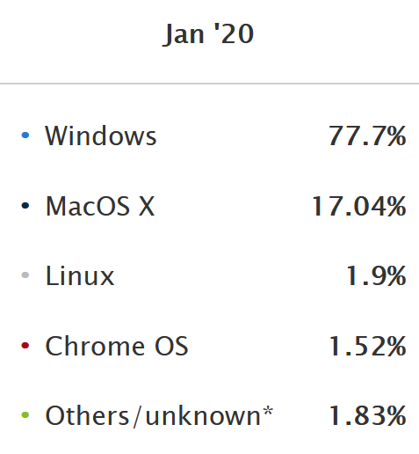
Desktop Environment
Obstacles:
1- Many different versions of Windows, or many different distribution of Linux (Can be solved by Docker)
2- Hardware: the type of the processor x32 or x64, number of core, IPC, RAM, Storage.
3- Drivers and optimization: (AMD vs Nvidia vs Intel)(Unity, Unreal, Direct X 11/12, Vulkan)
Image source: statista.com

Slide 6
WEB Environment
Obstacles:
1- Many Browsers architecture
2- Stability of Internet connection
But!!..
It does work everywhere despite some very minor problems

Slide 7
WEB APPLICATIONS ADVANTAGES
Flexible
Lightweight
No need to install or download
Mostly free of dependencies

